Slide 1
Faculty Experience: Startups
- Frank Liou

Slide 2

Agenda
Introduction
Examples: startup research and commercialization
Why startup?
How to begin?
Challenges
Funding for a startup

Slide 3
About me
Bytnar Professor, Mechanical Engr.; Director, ISC
Research focus: Rapid Prototyping, Additive Manufacturing, Digital Manufacturing
Courses developed: ME 5708 Rapid Product Design and Optimization; ME 6659 Advanced Topics in Design and Manufacturing
Book: Frank Liou, Rapid Prototyping and Engineering Applications: A Toolbox for Prototype Development. CRC Press, 2019 (2nd Edition), ISBN-13: 978-1498798921.

Slide 4
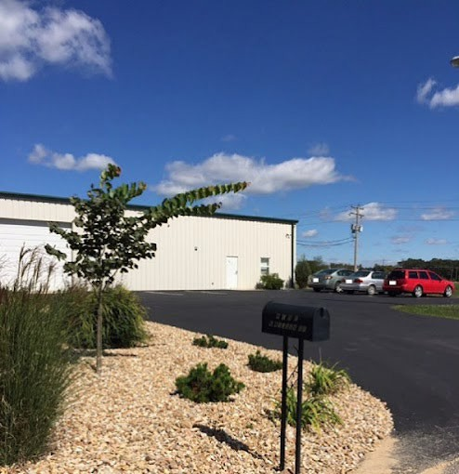
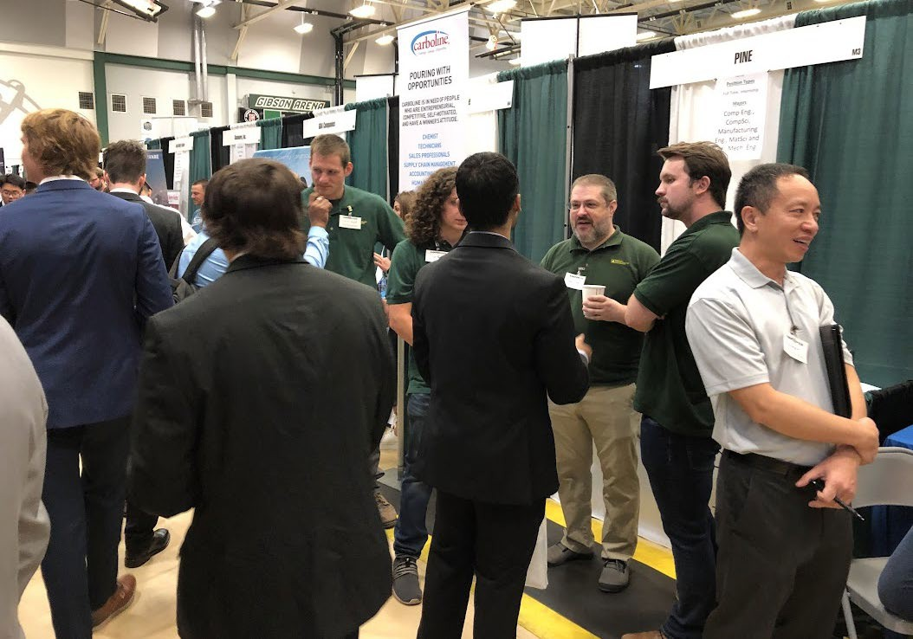
About the company
Product Innovation and Engineering (PINE), LLC
Founded in 2002
St. James Industrial Park
Member, S&T’s Center for Aerospace Manufacturing Technologies (CAMT)
PINE
Recruiting engineers at S&T career fair

Slide 5

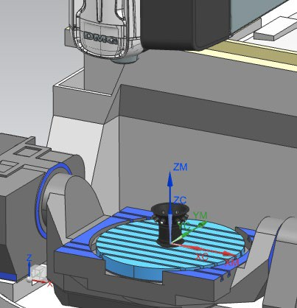
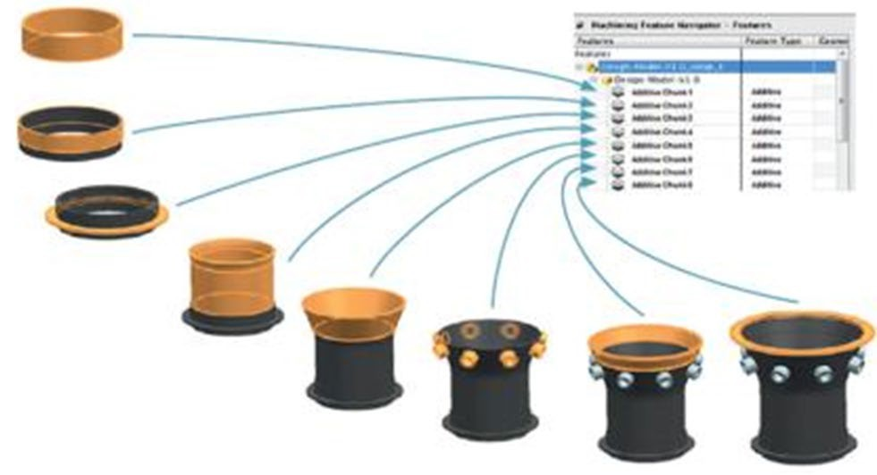
Siemens PLM: NX Hybrid Manufacturing
Sponsor: NSF STTR; Siemens PLM

Slide 6
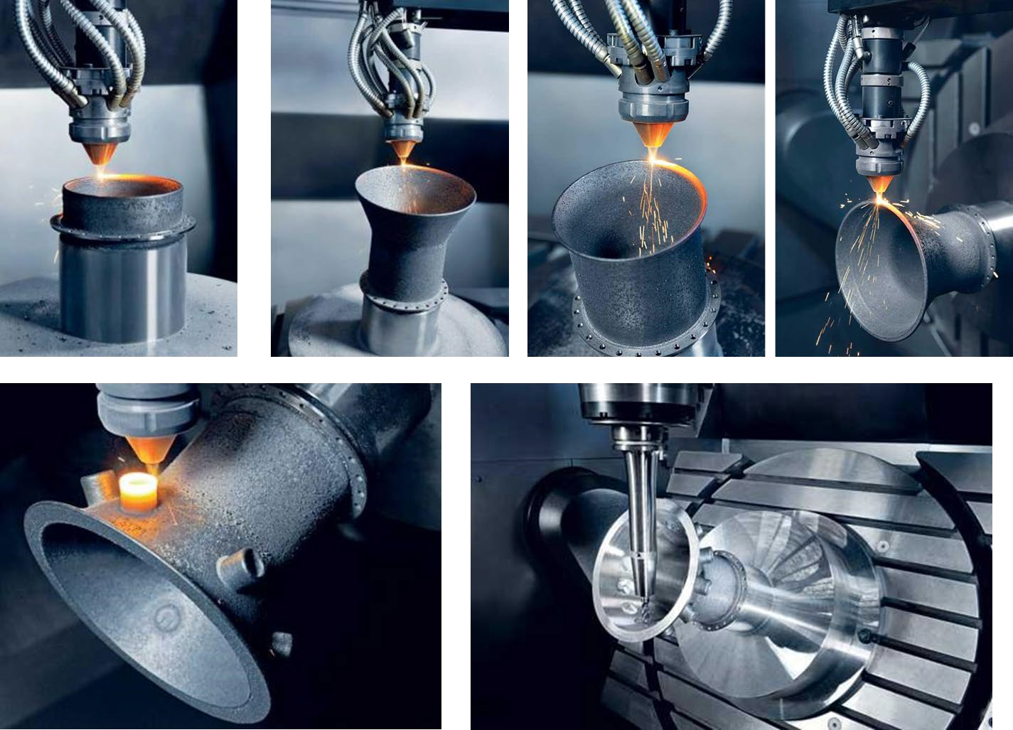
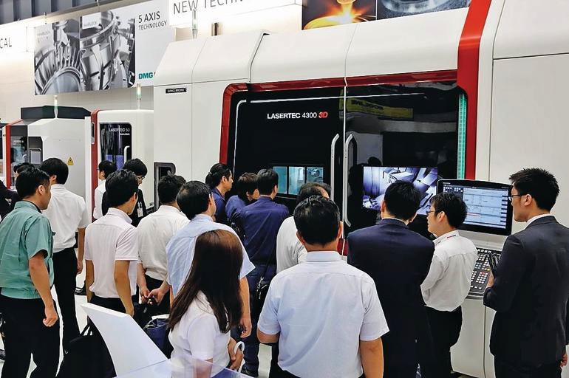
DMG/MORI Lasertec
DMG/MORI Lasertec 65, 125,
3000, 4300, 6600
DMG/MORI donated “Franky” Lasertec 4300 to S&T

Slide 7
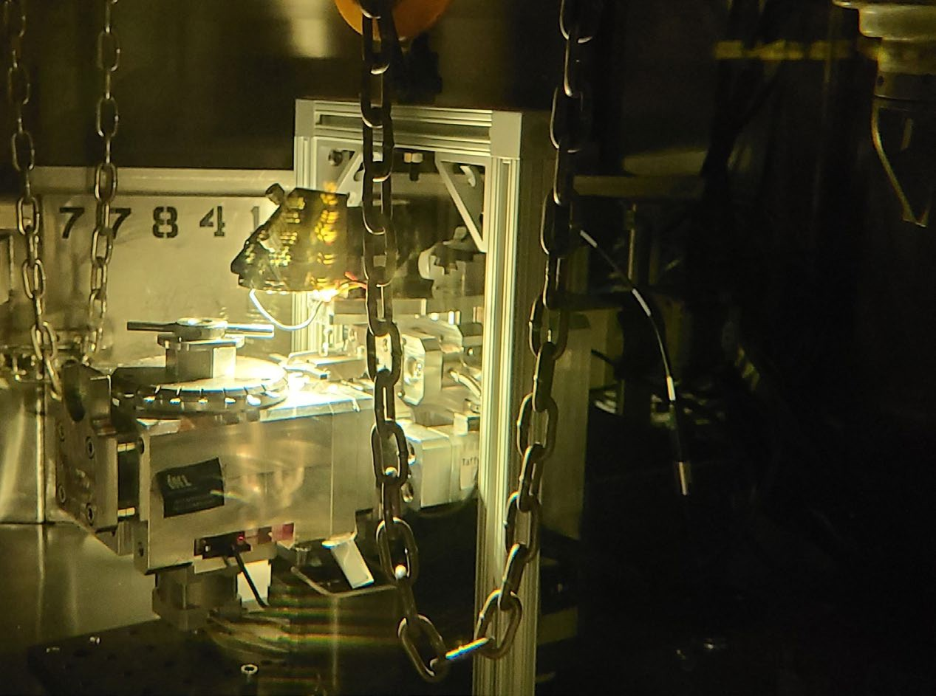

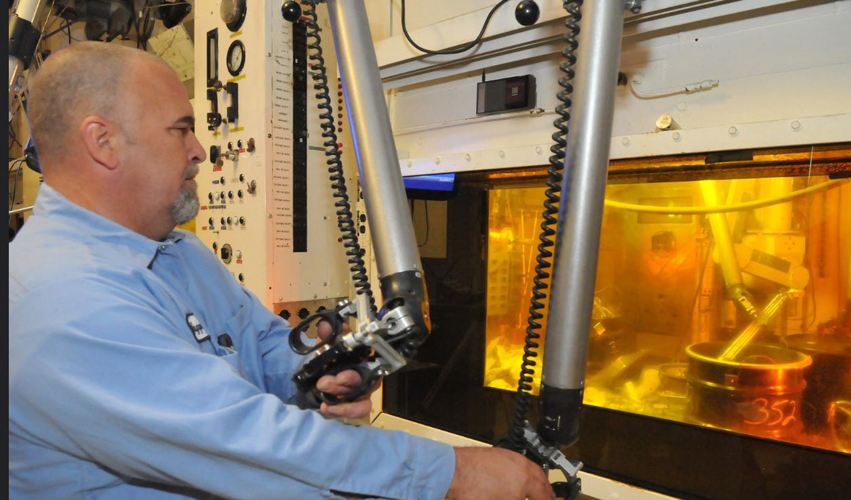
Automated Mini-tensile Testing System
Sponsor: DOE STTR One unit installed in
Idaho National Lab’s (INL) hot cell.

Slide 8

Why Startup?
“Starting up your own business is one of the most rewarding achievements in life. It gives you freedom, which is by far the most powerful outlet for self-expression.”
Leonardo Gubinelli, co-founder of Study Abroad Association

Slide 9
How to Begin?
“Do what you love, and success will follow.”
- Meg Whitman, former CEO of eBay Inc. and HP Inc.

Slide 10



Challenges to Establish A Startup
Time (much more than 8-5)
Expertise (technology, finance, management)
Attitude (innovative thinking, persistence)
Money (never enough for a startup)

Slide 11
Looking for tech startup support?
Small Business Innovation Research (SBIR) and Small Business Technology Transfer (STTR) Programs
3.2% of the research budget for agencies with a budget greater than $100 M per year
Phase I ($150k~$250k) , Phase II ($0.5M~$1.5M)
The government will invest and hope that you can develop and commercialize it

Slide 12
Thank you!!
Questions?

